Slide 1
Rotating LED display
Spencer Ball
Nikoo Givehchian
Kevin Kim
Eddie Tian
ECE532 2023
Notes:
From ECE 532H1 S LEC0101 (piazza.com)
Here is an outline of what I’d like to see in your presentation:
title of project and team members
overview of the topic to remind us what you are doing
proposed system from last time - block diagram
current system block diagram - what is different and why
challenges so far
what did you demo?
what’s left to do? - any changes to fit the remaining time
what do you plan to do for the final demo?

Slide 2
Project Overview and block diagram

Slide 3
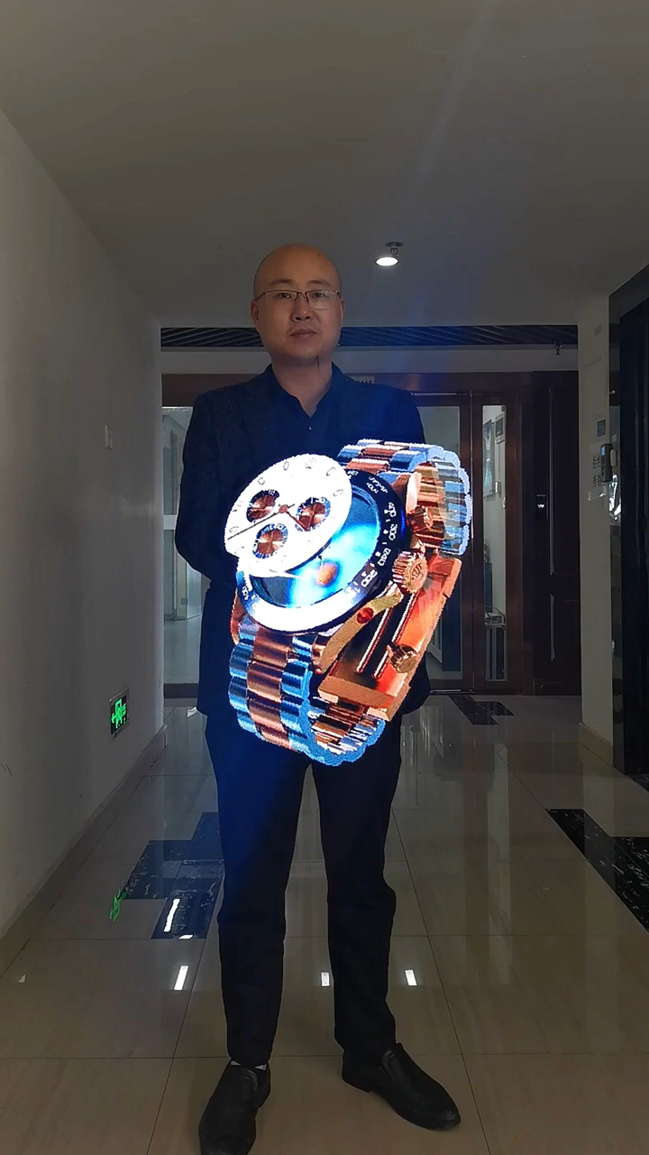

Slide 4
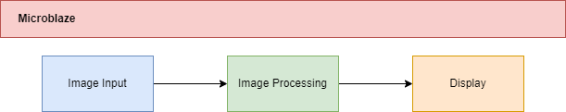
Project Overview
Notes:
Microblaze is system management, sends control signals to each part of our project
Three sections: input, processing, display
Each section is comprised of smaller blocks. The approach would be to test independent blocks, then converge our way up the hierarchy.
Each section is its own (big) milestone, integrating is a milestone
Each section can be scaled forwards or back in complexity in case if we run out of time or have extra time

Slide 5
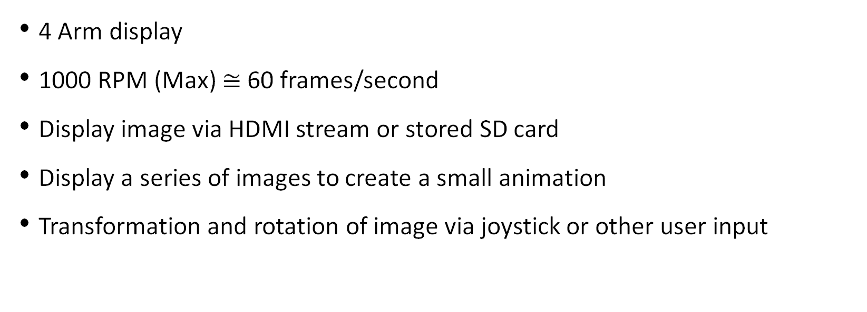
Initial Project Scope
4 Arm display
1000 RPM (Max) $≅$ 60 frames/second
Display image via HDMI stream or stored SD card
Display a series of images to create a small animation
Transformation and rotation of image via joystick or other user input
Notes:
• what your initial goals were
so this slide would go through the initial goals of the overall project
Subsequent slides will explain initial block design vs what was actually achieved for each block

Slide 6
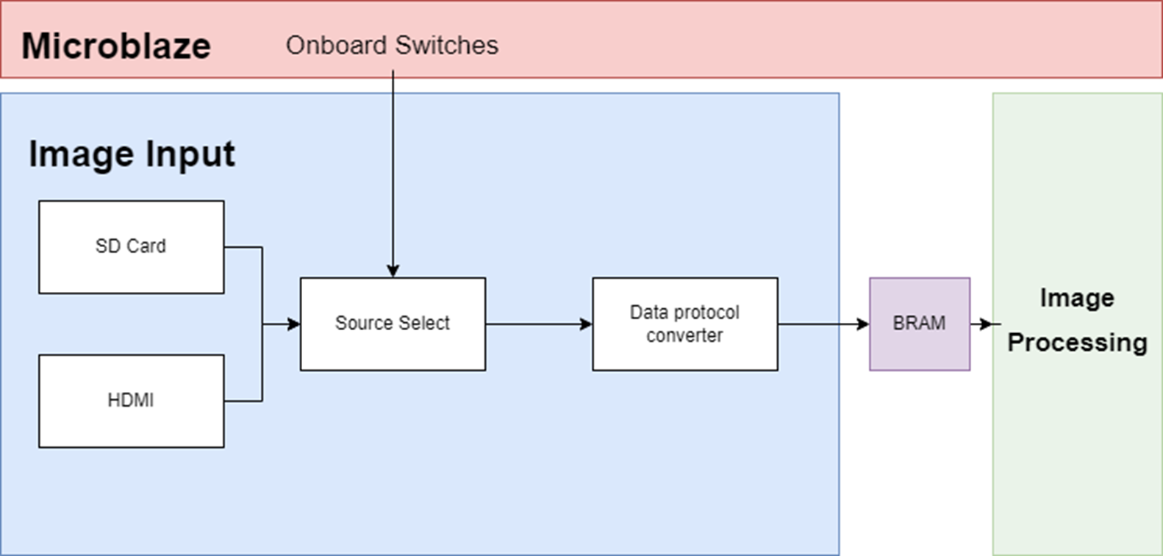
Initial Image Input Design
24
Initial design features two image sources and full 24-bit colour depth per pixel
Notes:
Eddie
The first section is responsible for image input.
Our original design supported both SD card and HDMI input, where it could either read a picture from an SD card or show a video stream from HDMI. The data protocol converter would read the BMP file metadata to determine the size, width, and other parameters, then read the bitmap information and convert it to 24 bit packets which were sent using an AXI lite master to BRAM. The strobe was set to 0111 in binary to only accept 3 bytes.

Slide 7
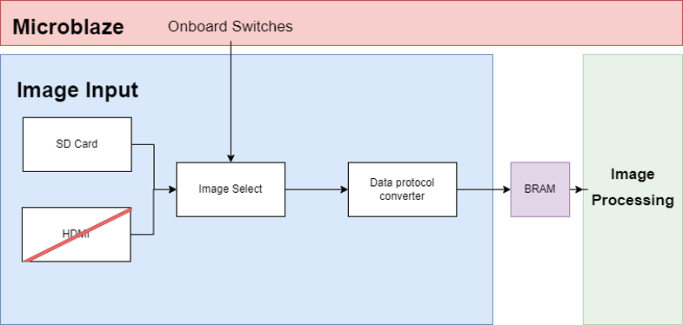
Achieved Image Input Design
6
Achieved design has only SD card as the source and the switches instead change which picture is read.
The data width is also 6 bits as there are insufficient resources to support 24-bit colour
Notes:
Our finalized design removed the HDMI stream as HDMI input was too time-consuming to implement and somewhat redundant with the SD card.
We also constrained the input image to only be 64 * 64 pixels since that is the resolution of our display and would simplify the entire project.
The data protocol converter does support 24-bit colour, but was changed to 6 bits per pixel to reduce the number of LUTs used in later modules.
The AXI lite protocol was unchanged except for setting the strobe to only one byte with 2 bits of padding.

Slide 8
Image processing block Summary
Planned to...
Have HDMI input
Have SD card input
Send 24 bit data
Use AXI to send data (sent directly to image processing block instead of indirectly through BRAM)

Slide 9
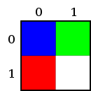
BMP File format
Offset | Hex Value (Little Endian) | Description
0 | 42 4D | ID field
2 | 46 00 00 00 | Size of file (54 byte header and 16 byte data sections)
... | ... | Other metadata
A | 36 00 00 00 | Offset where data begins
... | ... | Other metadata
12 | 02 00 00 00 | Width of picture
16 | 02 00 00 00 | Height of picture
... | ... | Other metadata
36 | 00 00 FF | Red (pixel 0, 1)
39 | FF FF FF | White (pixel 1, 1)
3C | 00 00 | Padding to maintain 4 byte alignment for end of row
3E | FF 00 00 | Blue (pixel 0, 0)
41 | 00 FF 00 | Green (pixel 1, 0)
44 | 00 00 | Padding to maintain 4 byte alignment for end of file

Slide 10
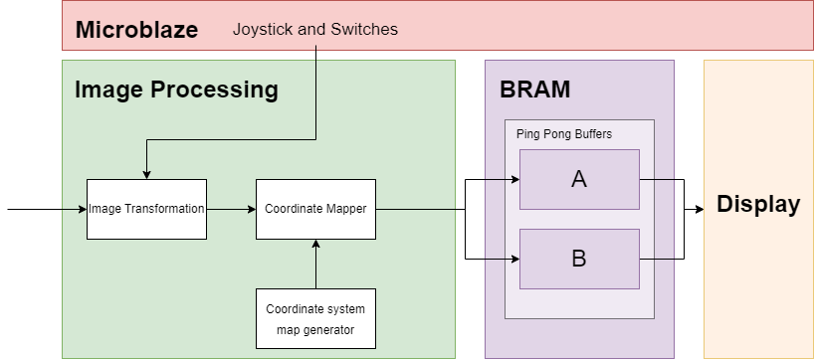
Initial Image processing proposal

Slide 11
Implemented image processing block

Slide 12
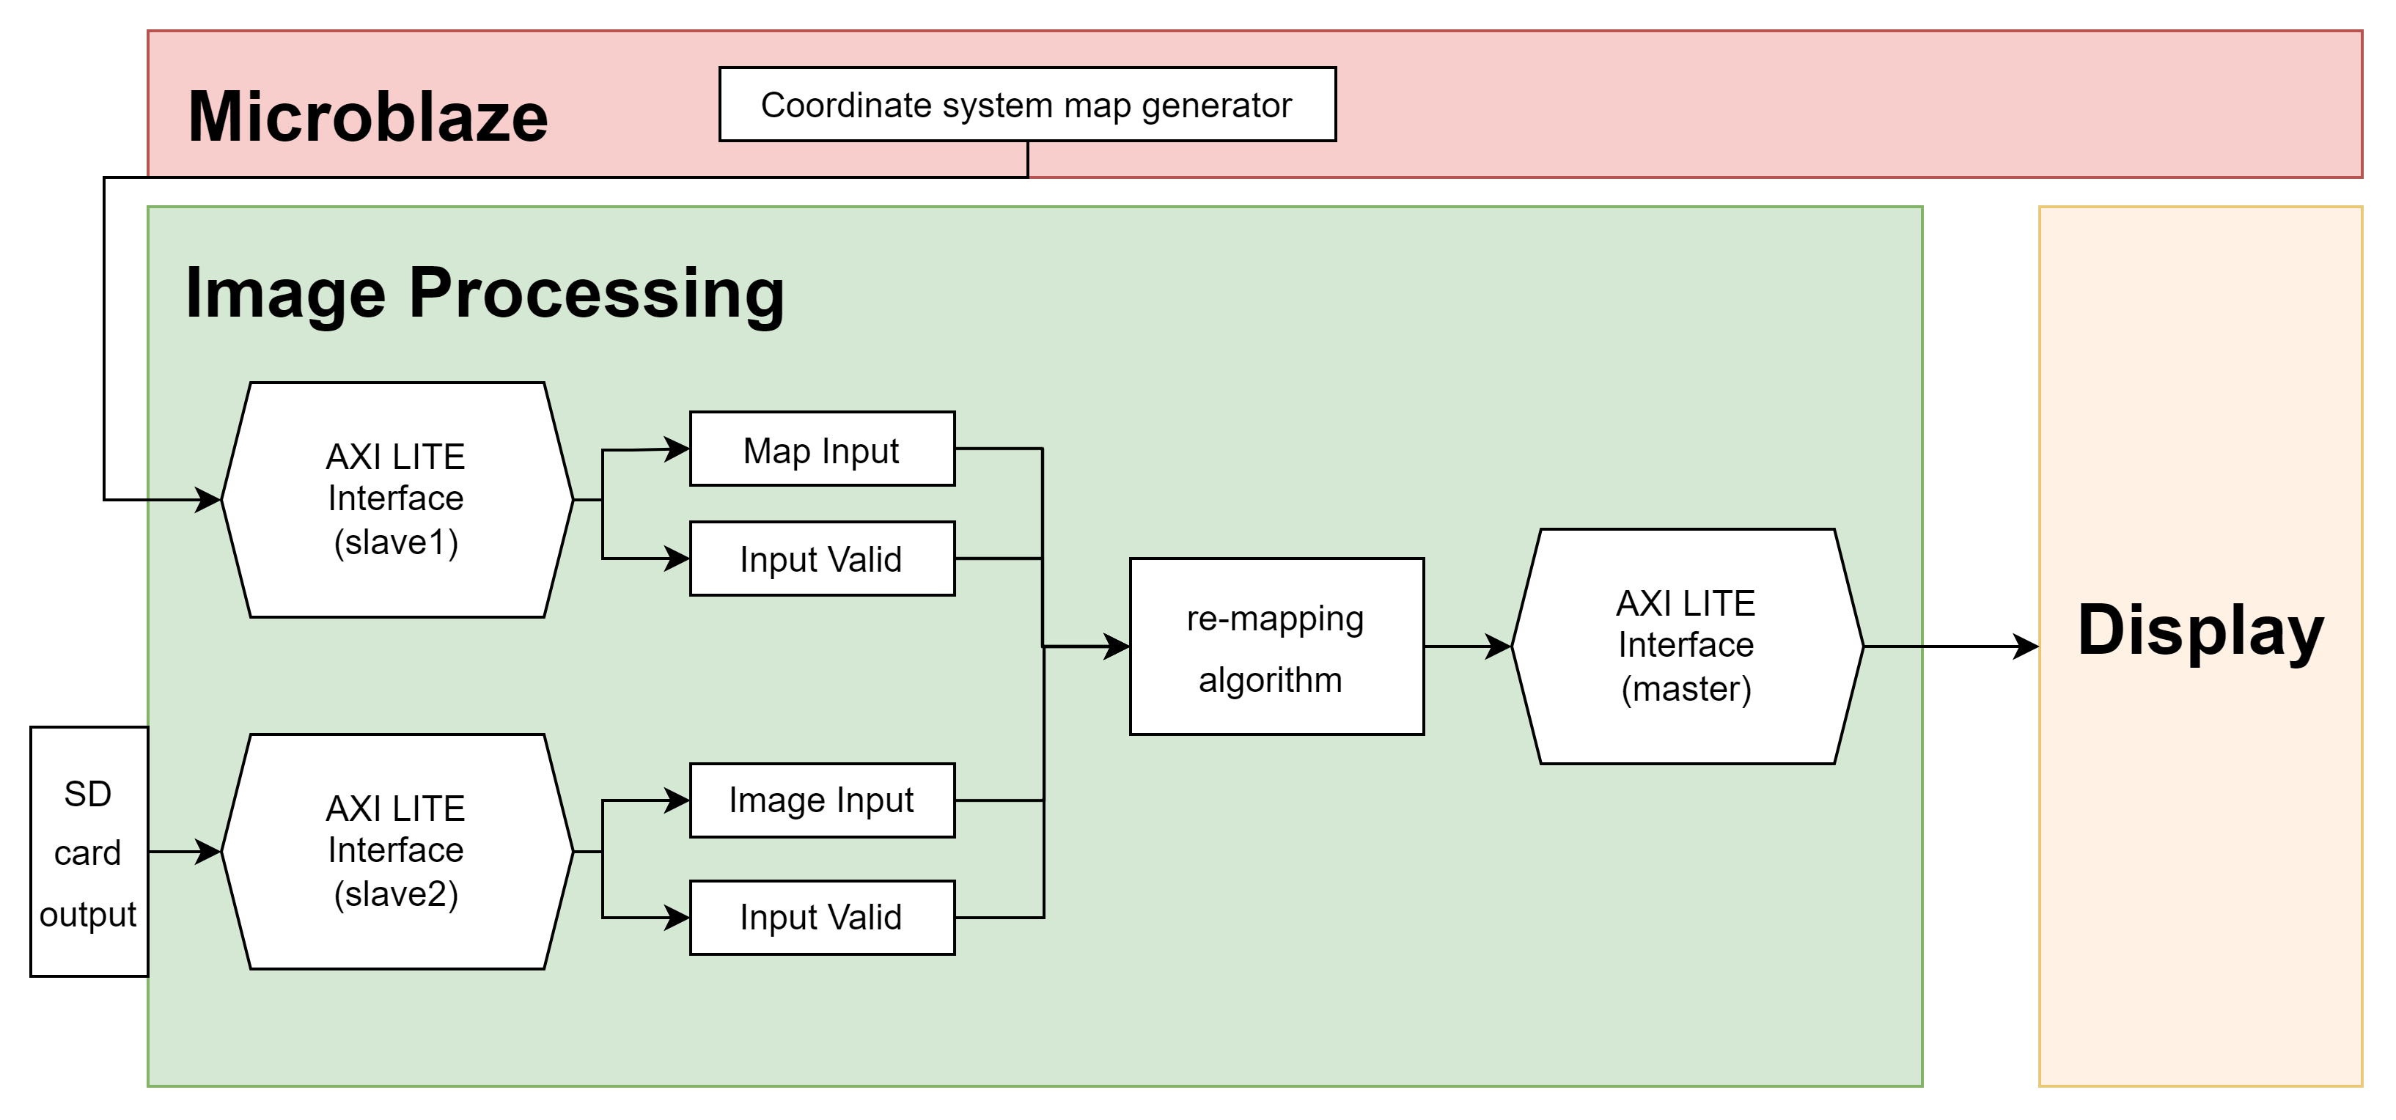
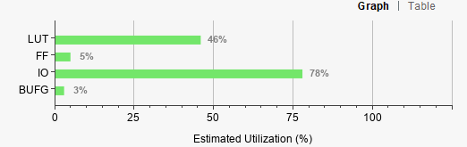
Implemented image processing block
Synthesis of block with 16 angles:

Slide 13
Image processing block Summary
Planned to...
Image transformation block and joystick
Transform input data to polar to send to LED driver
Receive image map from the Microblaze
Send data directly to LED drivers instead of ping pong buffers

Slide 14
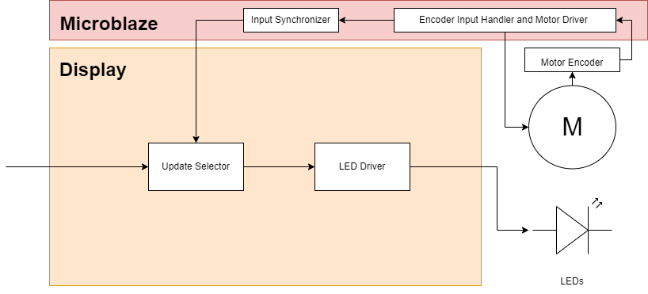
High Level Overview of Display Driver
Notes:
This was our original high-level overview of the Display Driver Block
By the middle of this project we didn’t have much trouble trying to realize this system and came up with the following detailed block diagram

Slide 15
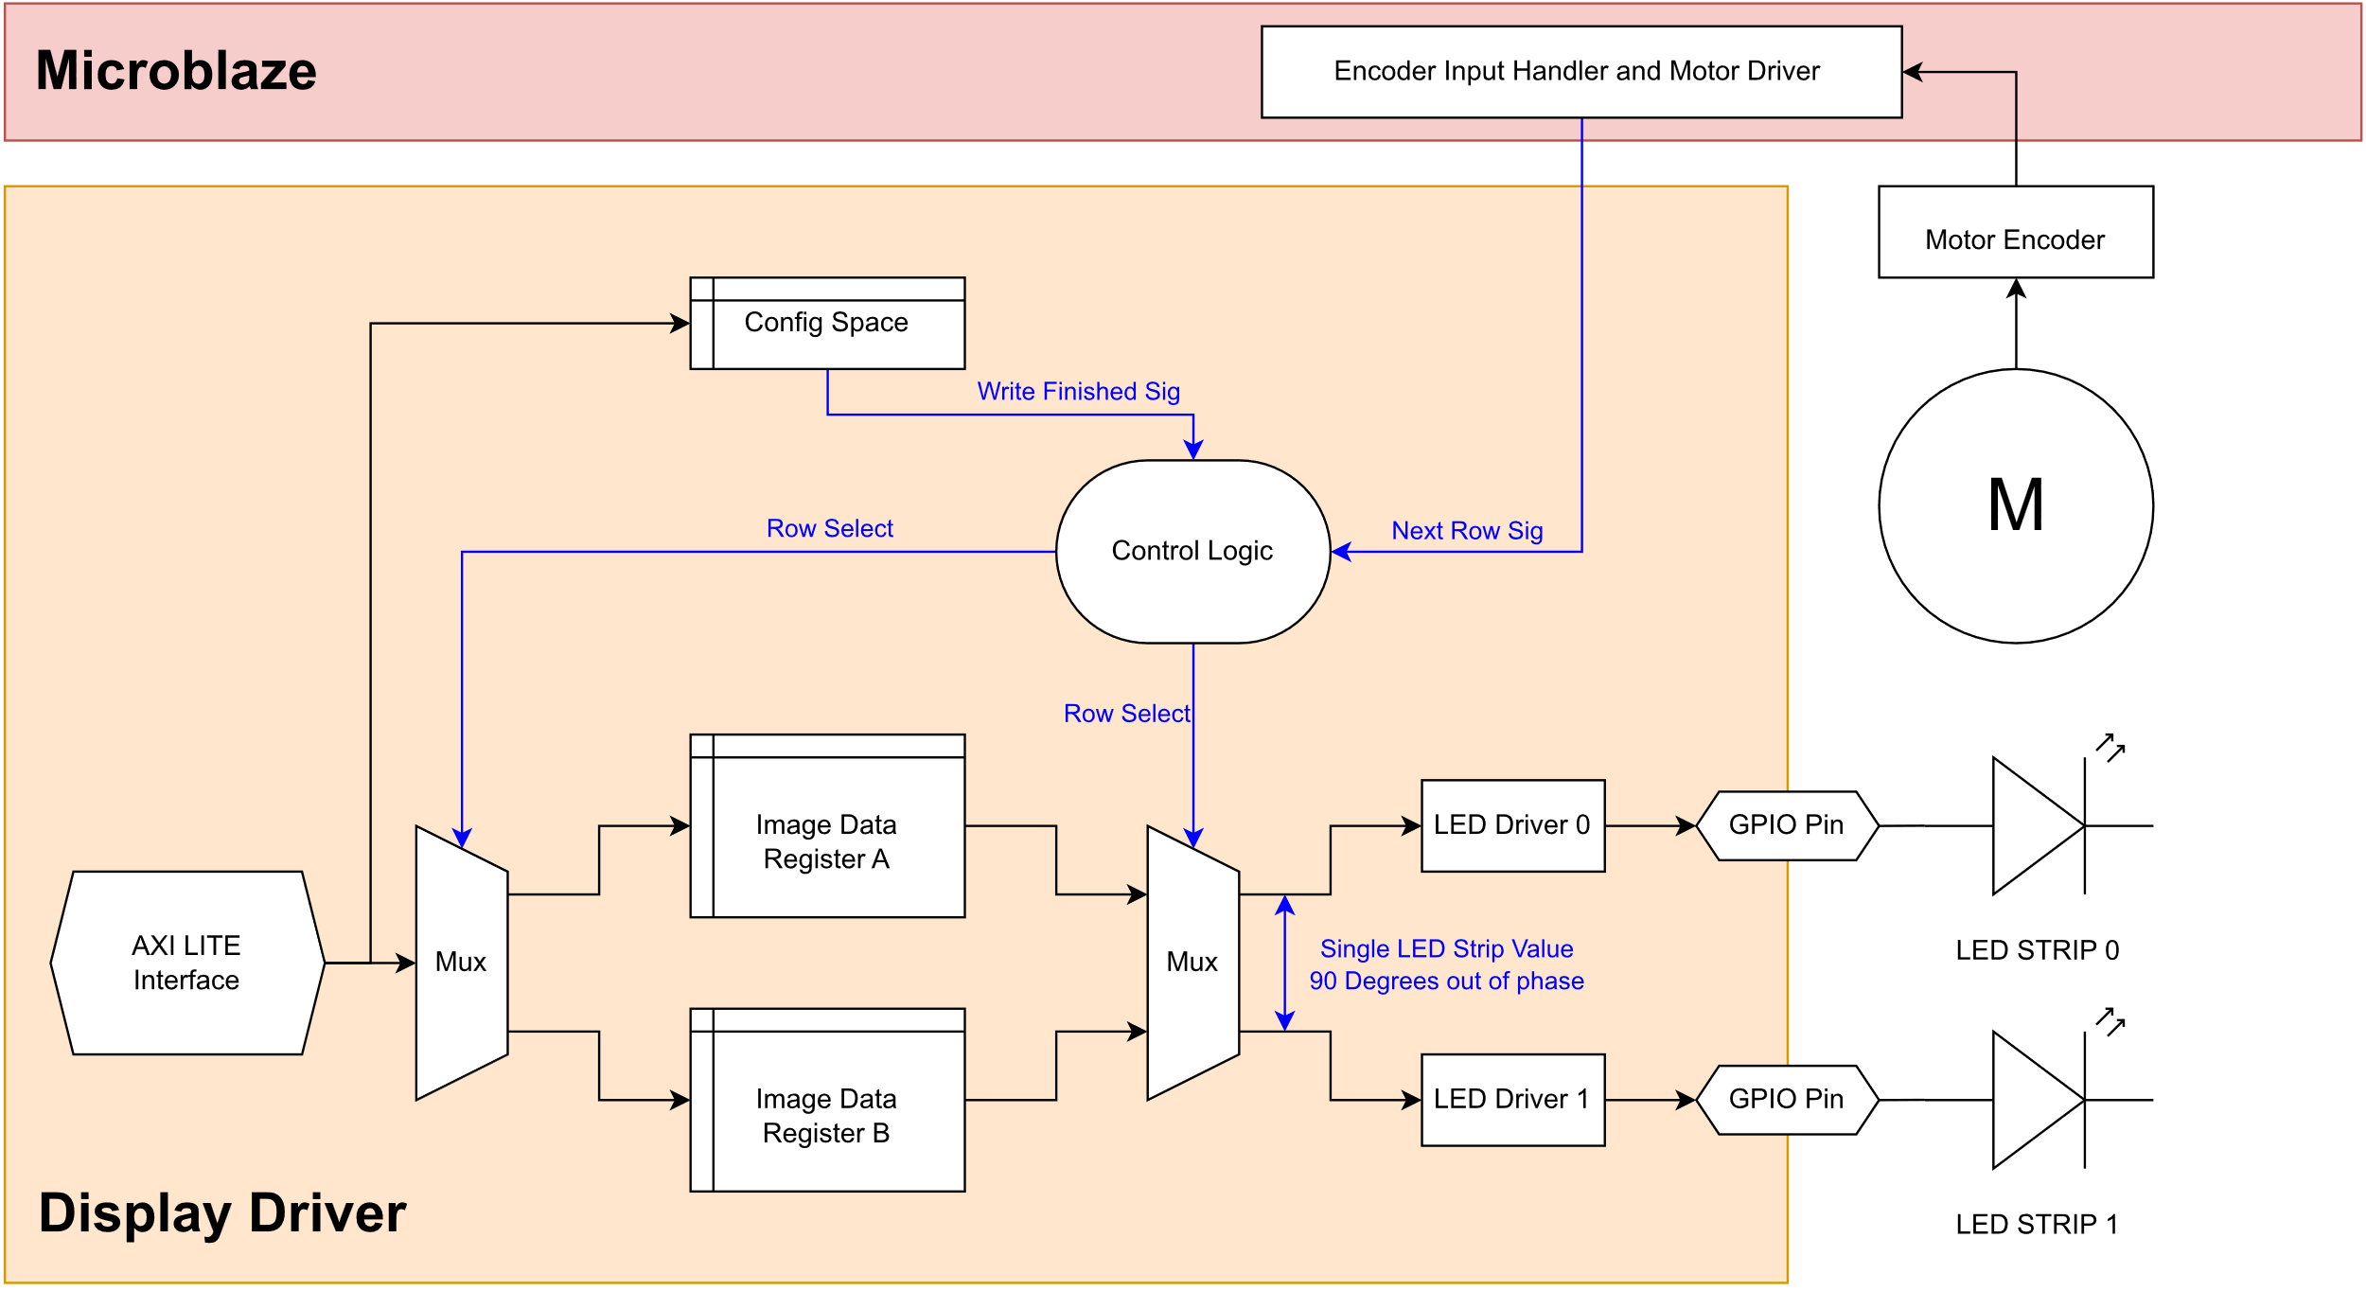
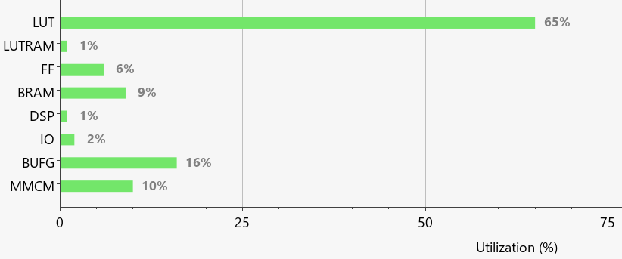
Display Driver V1
Synthesis of block with 16 angles, 16 Leds, w/ microblaze
Notes:
This more detailed version featured a ping-pong buffer system to allow simultaneous reads and writes.
The block was designed with easy testing in mind. Control signals such as write-complete to declare that a master had finished writing to a ping pong buffer were to be sent over AXI such the block could easily be controlled an integrated via a microblaze to reduce implementation time requirements.
There was one significant issue with this design however, and it is an issue that would continue to haunt our design until the very end. We were limited on LUT resources.
We were facing extremely long implementation times and 90%+ LUT utility from a low number of rows stored. This meant that the granularity of led values we could achieve as a function of angle was extremely limited.
This was mainly due to the fact that the registers were addressable via the AXI lite interface, and also due to the usage of muxes from the ping-pong buffer.
We then had to re-design this structure to minimize LUT usage.

Slide 16
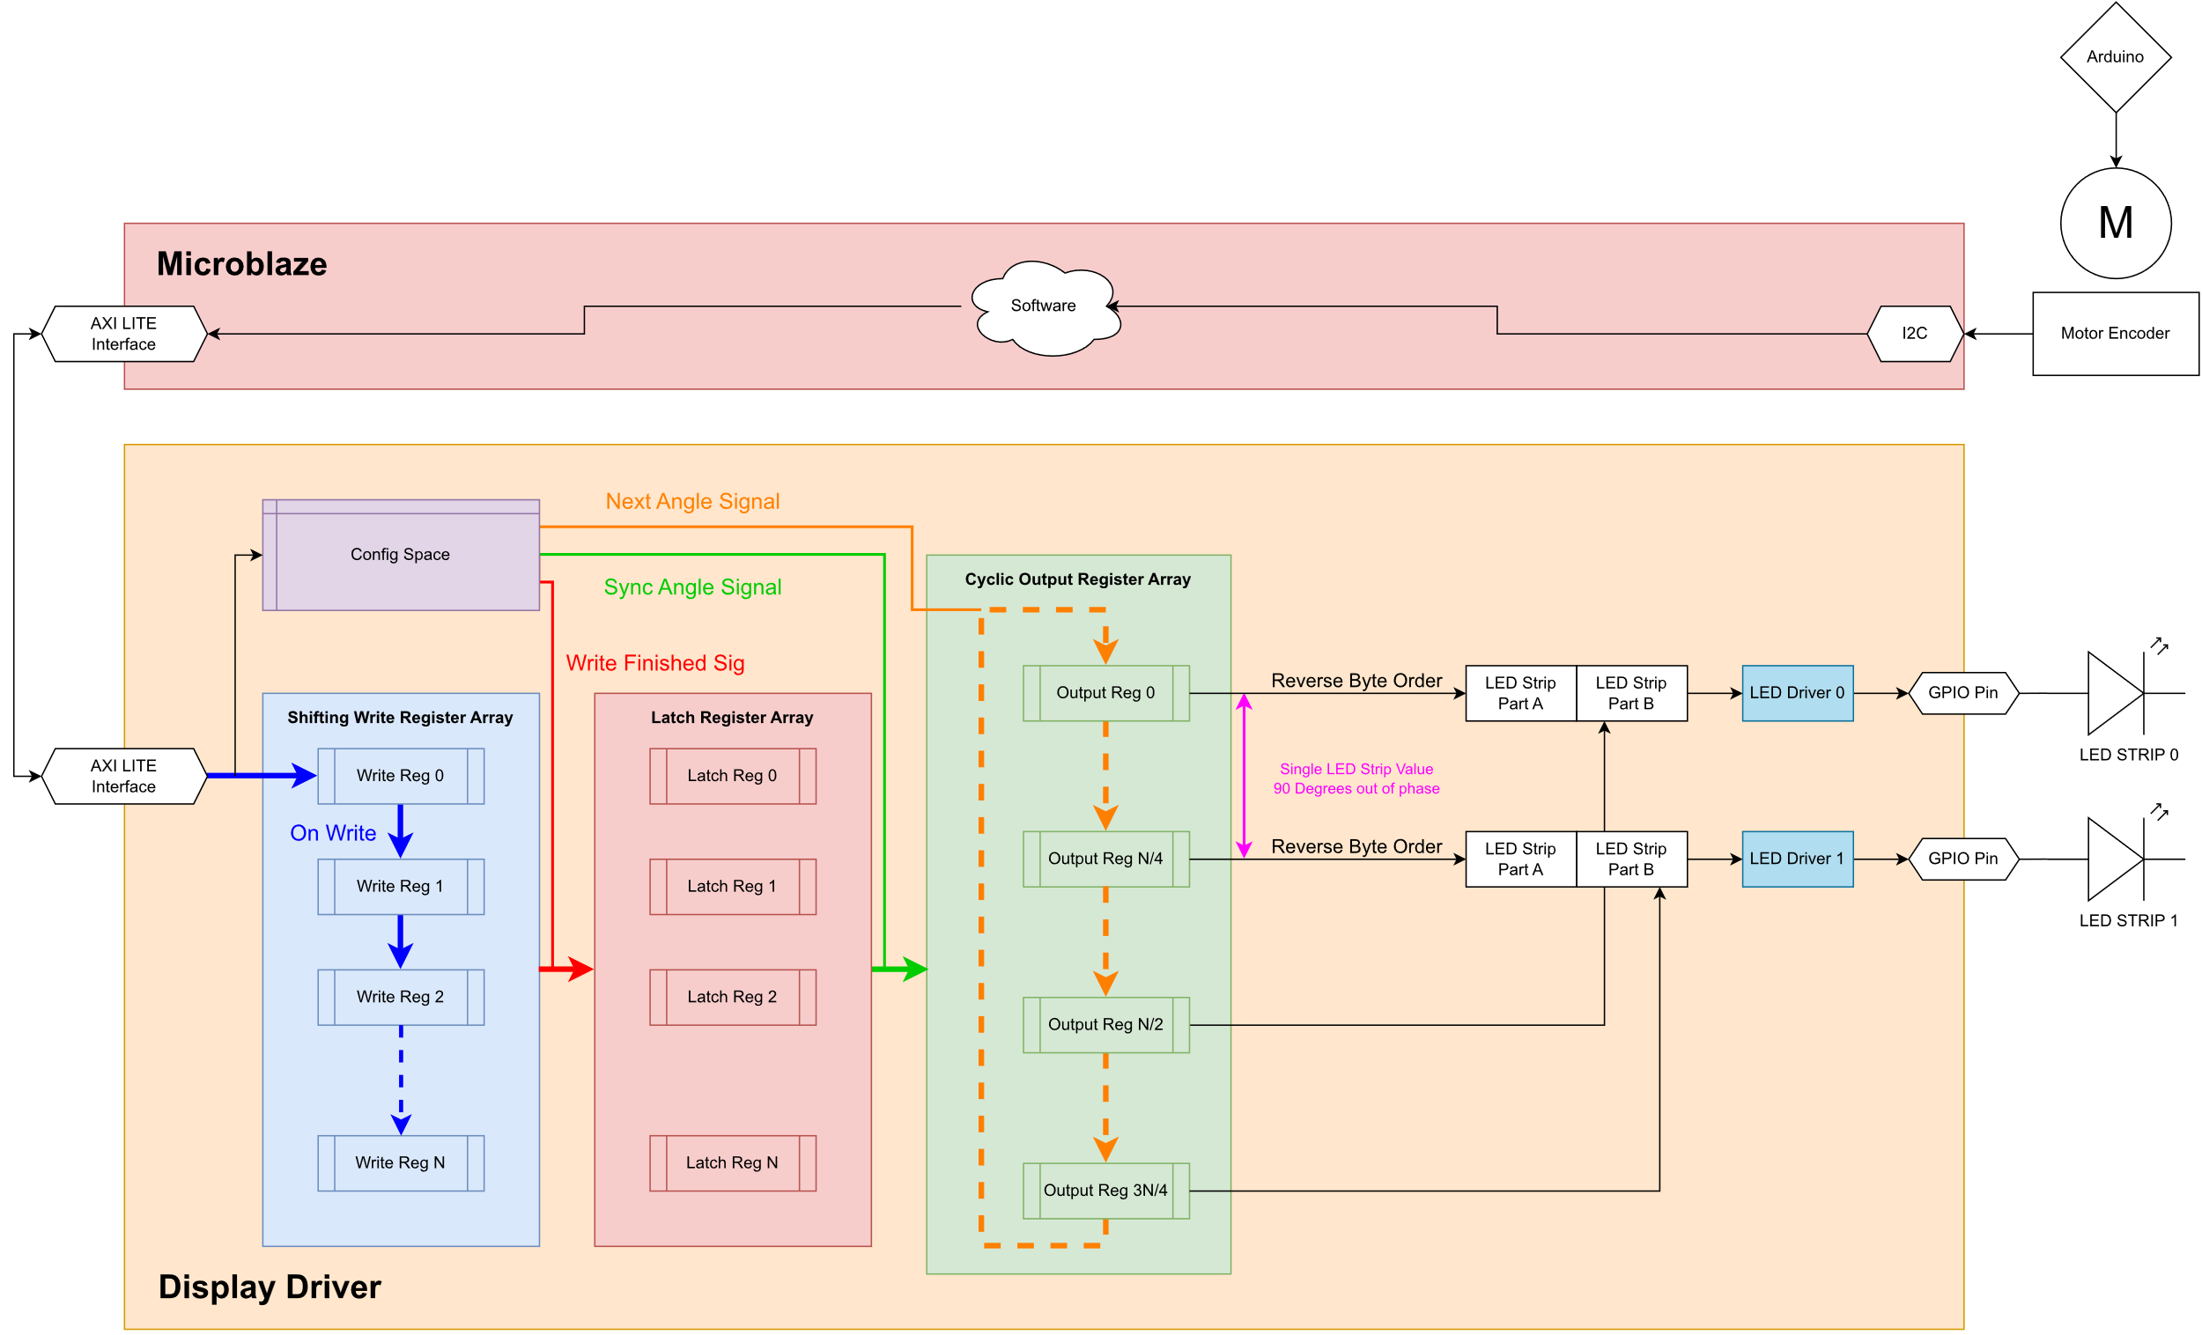
Display Driver V2
Notes:
This is the final Display Driver Architecture.
We use a significant number of Shifting FF to store the LED values.
The axi lite interface can no-longer address the entire array, and can only write to a single register.
On a write to this register, the values stored is shifted down the write array.
The config space was expanded to also carry a next angle signal, a sync angle signal as well as the write finish signal.
When write finished is declared via the config space, a latch register stage is used to hold the value of the written array.
The data in the latch register is only moved to the output array when the sync angle signal is raised. This is to ensure phase synchronization in the image.
The output register layer is a cyclic register array. To avoid utility of LUTs, there are wires that are directly assigned to the 0, N/4, N/2 and 3N/4th register of this array.
When next angle signal is raised, the register array is circularly shifted by the width of one row. This then changes the values arriving at the LED driver.
We still had some issues with resources so we had to also reduce each LED value to 8 bits. 2 bits padding, 2 bits per color. The padding bits are stripped during write such that only 6 bits are stored per LED in the registers.

Slide 17
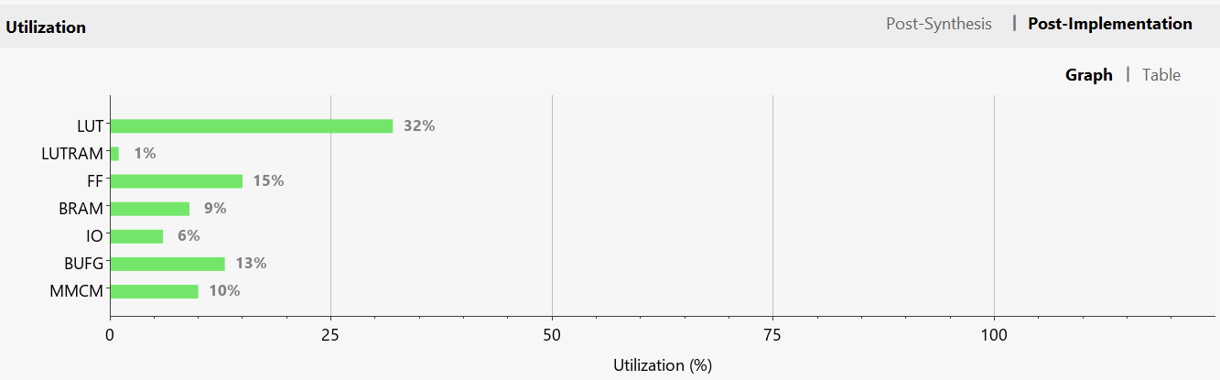
Display Driver V2 Utilization
Synthesis of block with 64 angles, 32 Leds, w/ microblaze

Slide 18

LED Driver Block
LED driver takes in a single row of LED value data
Sends bits through a single data line
Time held high & low indicates a 1 or a zero a 0
Notes:
The LED driver block is simply a custom state machine, counting the number of clock cycles to generate the bitstream specified by the WS2812B Protocol

Slide 19
Display Driver Summary
Planned to...
Full 24bit color per LED color
R/W LED values through AXI Bus
Control signals such as synchronization and next angle Through AXI

Slide 20
Microblaze
Planned to...
Control motor via HBridge PMOD
Read encoder via I2C bus to synchronize updates
Send map to the Image Processing block
Use joystick to make image interactive

Slide 21
Microblaze
Blocking issues
Control motor via HBridge PMOD
PMOD has 2A current limit, needed high power driver.
3.3V logic not working with new motor driver, even with level shifter.
Max PWM frequency with pre-canned IP is 1kHz, new driver wanted 16kHz.
Use joystick to make image interactive
Ran out of time

Slide 22
Thanks For listening!

